Slide 1
Glycolysis
Ashli Robertson
&
Shahrzad Saba

Slide 2
Introduction
  Common energy storage molecules:
    ATP, NADH, Acetyl- CoA
  It requires energy to generates these molecules, and when they are broken down, it releases energy
  Broken down products are more stable
    Lesser the stability of a molecule, higher the energy its release after it breaks down

Slide 3
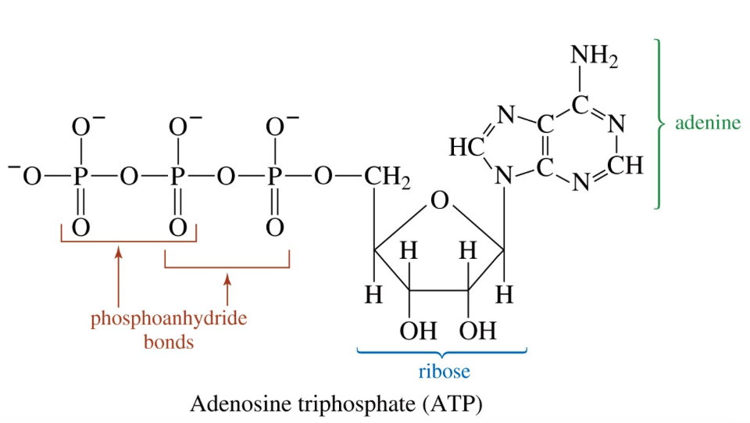
Structure of Adenosine triphosphate (ATP)
Two important functional groups
  Five carbon sugar (Ribose), 3 Phosphate groups
  Two high energy bonds & one low energy bond
Notes:
ATP, ADP, AMP.

Slide 4
ATP Hydrolysis
It will release energy
Why are the hydrolysis (broken down) products more stable?
  less charge repulsion
  One of the products is [H+], which is removed due to a buffer
  Products are better solvated

Slide 5
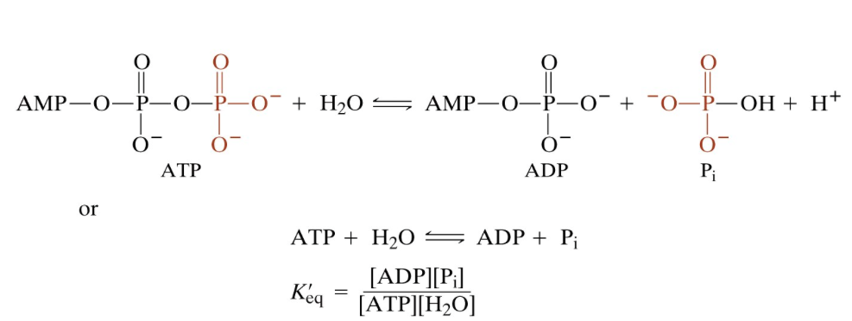

Slide 6
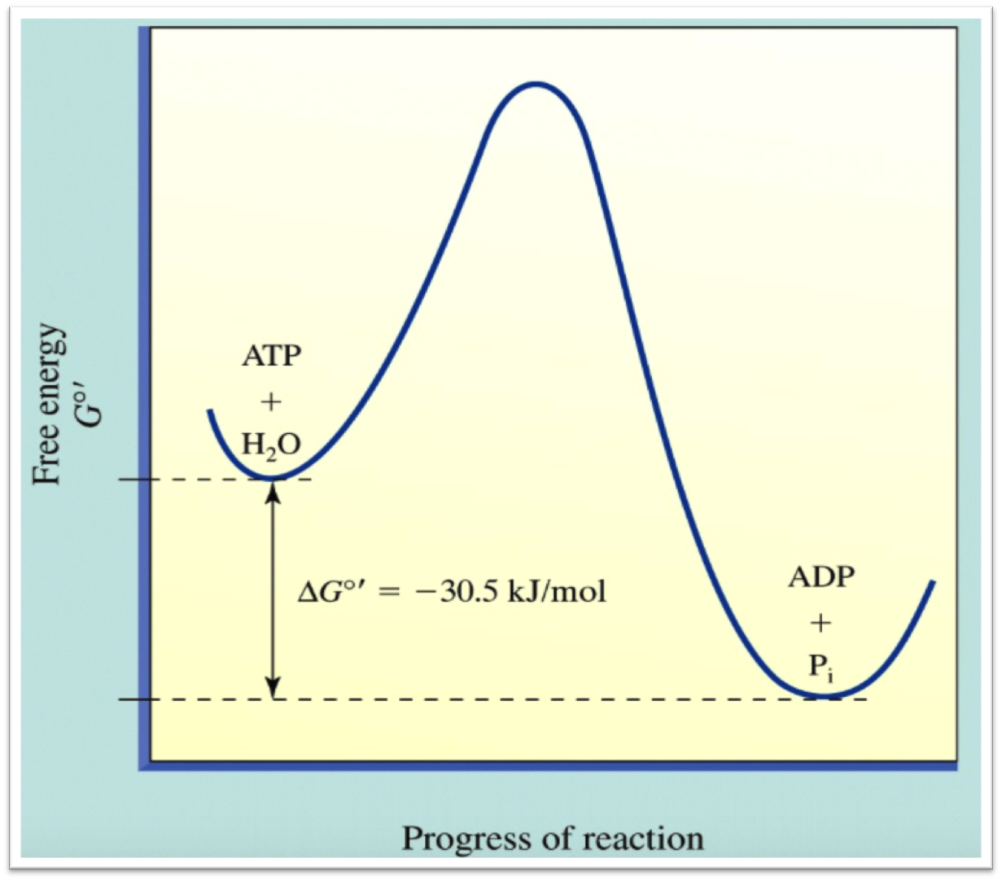
Notes:
ATP hydrolyses, Cutting with water.

Slide 7
What are the uses of ATP?
For a human with bodyweight of 70 kg (154 lb), this person will make and breakdown 65 kg of ATP in one day. In the body we only have about 50g of ATP, so each ATP is recycled about 1300 times a day.
  Energy coupling and active transport processes, Cells need to maintain an ionic gradient (In the kidney and brain cells more than 65% of ATP is used for this purpose)
  Muscle contraction
  Organelle or cell movement

Slide 8
Glycolysis
Introduction
  It is a universal pathway
  Anaerobic pathway; only pathway in animals that produces ATP without oxygen
    Important for diving mamals and their main source for metabolic energy
  Cell location: Mitochondria cytosol (not compartmentalized in organelle)
  Low energy process (especially under anaerobic conditions)
    Use 2 ATP under Anaerobic condition
    2 ATP and 2 NADH under Aerobic condition
Notes:
1-It will be sole source of energy for erythrocytes (RBC), renal medulla, brain.
2- It is a primitive pathway.

Slide 9
Function of Glycolysis
This happens in 2-fold
  Produces energy in form of ATP and NADH
  Produces building blocks or intermediates, mainly in synthesis

Slide 10
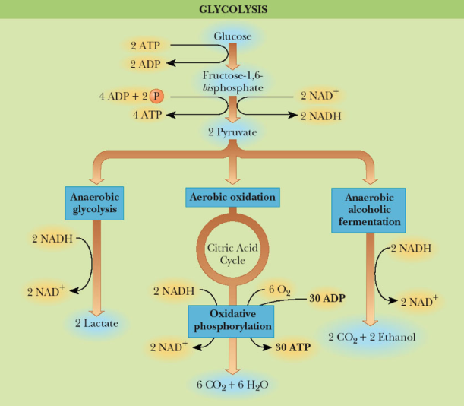

Slide 11
Overview of Pathway
Series of ten reactions
  Glucose → 2 Pyruvates
Fate of Pyruvate depends on the organism/conditions
  Pyruvate can be converted into
    Lactate or ethanol +CO₂
    Acetyl-CoA
Two reactions require ATP
Two reactions produce ATP
Notes:
2 ATP in step 1 and 3, which is the first stage of the glycolysis and it will break down the glucose in to two 3 C molecules. Addition of P to glucose (6 C sugar) and to Fructose 6 phosphate (5 C sugar)

Slide 12
Energy yield
Used up in pathway:
  2 ATP
ATP generated:
  4 ATP
NADH generated:
  2NADH
Net result:
  2 ATP & 2 NADH
  2 Pyruvate
Notes:
2NADH in step 6. one for each PGAL
2ATP in each of the steps 7 and 10.

Slide 13
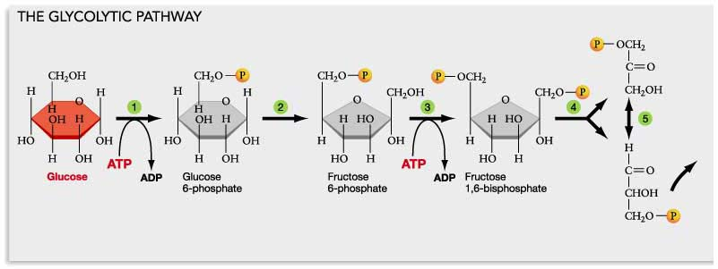
First Stage

Slide 14
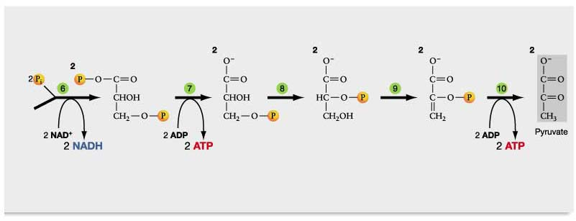
Second Stage

Slide 15
Fate of Pyruvate
Anaerobic organisms
  The key to the fate of Pyruvate in anaerobes is that for glycolysis to continue, it is necessary to reduce Pyruvate and to regenerate NAD⁺. Without NAD⁺ glycolysis would slow down and eventually stop.
  Anaerobes do this by two routes
    Conversion of Pyuvate to lactate
    Conversion of Pyuvate to CO₂ and ethanol by yeast
Notes:
Reaction 6 in the pathway. Reduction of the pyruvate will be the source for NAD, by converting NADH to NAD.

Slide 16
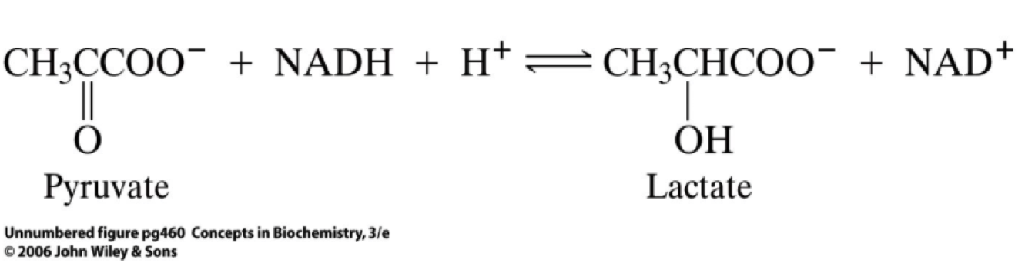
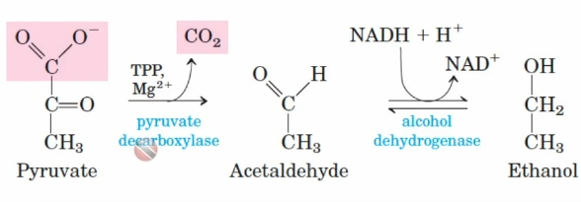

Slide 17
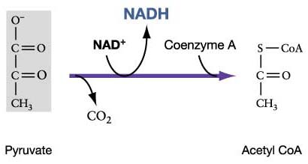
Fate of Pyruvate
Aerobic organisms
  Generation of Acetyl- CoA
  Acetyl-CoA continues in Krebs Cycle

Slide 18
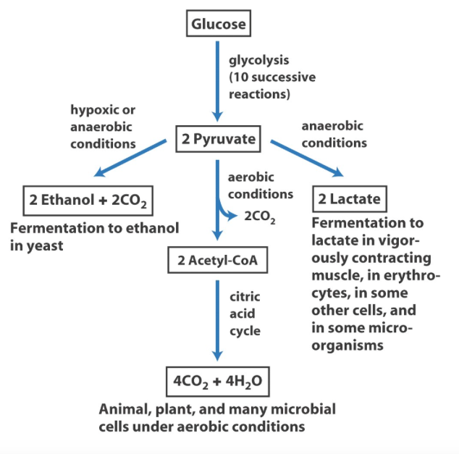

Slide 19
Pyruvate Usage
Skeletal muscle in animals
  Introduction:
    Skeletal muscle is designed to perform two different functions and to handle two different metabolic conditions. Skeletal muscle can be separated into two different types:
      A) red fibers (slow- twitch)- type 1
      B) White fibers (fast-twitch)- type 2

Slide 20
Red Fibers (slow-twitch)
Contains a large amount of mitochondria and lots of blood vessels and is red in color, due to the Heme proteins
Designed for repeated contractions over a long period
Pyruvate is converted into Acetyl-CoA and then into Co₂. These are aerobic conditions and NADH is converted back into NAD⁺ in the electron transport chain (in the mitochondria)
In turkey and chicken, this is brown/dark meat: leg muscle, thighs

Slide 21
White Fibers (Fast Twitch)
High concentrations of glycolytic enzymes, LDH, and low amounts of mitochondria. This makes the muscle white in color.
Designed for short bursts of intense activity. Muscle activity is so intense that ATP is used up faster than it can be supplied by mitochondrial respiration. In going from resting muscle to active muscle, the rate of glycolysis goes up 1000 times
Under these conditions, Pyruvate builds up and to regenerate NAD⁺, it is necessary to reduce Pyruvate to lactate. The reaction is catalyzed by LDH, and the reason is to regenerate NAD⁺.
In turkey and chicken this is white meat: breast,& wing

Slide 22
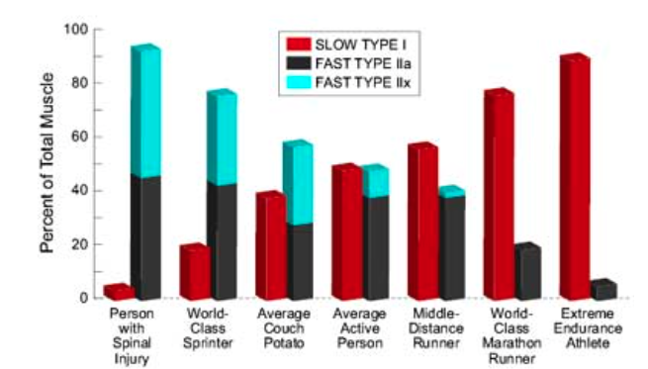

Slide 23
Effects of Training on Human Skeletal Muscle
A) In general:
  1) More mitochondria and more blood vessels (more efficient use of oxygen and fatty acids)
  2) Conserves glycogen and glucose

Slide 24
Effects of Training on Human Skeletal Muscle
B) Weight Training
  1) Develops fast- twitch muscle
  2) Increases muscle mass
  3) Little increase in respiratory capacity
C) Endurance Training
  1) Develops slow- twitch muscle
  2) Increases respiratory capacity
  3) Does not necessarily increase muscle mass

Slide 25
Hey Sugar :D
https://youtu.be/EfGlznwfu9U
Notes:
https://youtu.be/EfGlznwfu9U

Slide 26
Reference
Lehninger Principles of Biochemistry
  By David L. Nelson & Michael M. Cox
  2008
Glycolysis Video
  https://www.youtube.com/watch?v=EfGlznwfu9U&feature=youtu.be
Glycolysis images
  http://www.uic.edu/classes/bios/bios100/lecturesf04am/lect12.htm

